Slide 1
DEPARTMENT OF COMPUTER SYSTEMS ENGINEERING
Session 2022–2026
B.SC. FINAL YEAR PROJECT DEFENSE
Academic Presentation
SafeSurf AI
FACULTY & INSTITUTION
Faculty of Engineering & Technology
Intelligent Cybersecurity Threat Detection System
Mirpur University of Science and Technology (MUST)
Centralized heuristic threat analysis, external API intelligence integration, and browser-level perimeter defense for web, email, and wireless environments.
Mirpur, Azad Jammu & Kashmir
PROJECT TEAM
PROJECT SUPERVISOR
Hamid Ali
Abdul Rehman
Haider Ali
Engr. Sehrish Abid
FA22-CSE-013
FA22-CSE-001
FA22-CSE-CSE-69
Department of Computer Systems Engineering, MUST

Slide 2
01. Context & Motivation
Introduction & Problem Statement
FYP Defense Presentation
THREAT VULNERABILITY FLOW
Phishing & Domain Impersonation
End User Interaction
Phishing domains spoof legitimate institutional services, tricking end-users via visual similarity.
Suspicious Website / Email Link / Open WiFi
Opaque Link Redirection
Email links use obfuscated URLs and multi-stage redirects to bypass standard spam filters.
Exposure to Cyber Threat & Credential Theft
Unclear WiFi Security Posture
Core Engineering Problem Statement
Users connect to wireless access points without understanding underlying cipher configurations.
Users require a unified, automated, and centralized preliminary security mechanism to evaluate threat vectors in real time across browser, network, and communication channels.

Slide 3
02. Scope & Architecture Overview
Objectives & Proposed Solution
System Scope
Core Project Objectives
Central Core Solution
Website Heuristics: Detect suspicious URL structures, brand impersonation, and missing SSL.
SafeSurf AI Platform
Email Parsing: Extract embedded links from message bodies for preliminary threat inspection.
WiFi Diagnostics: Analyze active OS network connection security parameters and cipher protocols.
Website Scanner
Email Scanner
WiFi Analyzer
Threat Intel Aggregation: Integrate VirusTotal v3 and Google Safe Browsing v4 APIs.
Threat Dashboard
Chrome Extension
Batch URL Checker
Browser Integration: Provide real-time page inspection via Chrome Extension (Manifest V3).
EXECUTION PIPELINE:
Analyze → Score → Classify → Explain → Store

Slide 4
03. Technical Blueprint
End-to-End System Architecture
REST Micro-Architecture
Client Interface 01
Client Interface 02
Web Dashboard (HTML5 / CSS3 / JS / Chart.js)
Chrome Extension (Manifest V3 Service Worker)
HTTP REST API / JSON
APPLICATION SECURITY MIDDLEWARE GATEWAY
CORS Hardening
SSRF Defense
Rate Limiter
Security Headers
Flask Router
Python Flask REST API Backend
127.0.0.1:5000
Engine Module
Engine Module
Engine Module
Engine Module
Engine Module
Website Analysis
Email Analysis
WiFi Diagnostics
Scoring Engine
Threat Intel Broker
External Threat Intelligence
HTTPS JSON
Persistence Layer
Local DB
VirusTotal API v3 | Google Safe Browsing API v4
SQLite Database (threats.db)

Slide 5
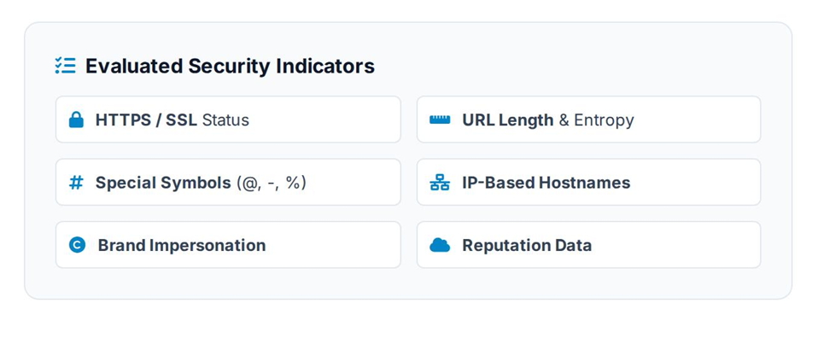
04. Core Analytical Component
Website Security Analysis & Scoring
Inspection Mechanics
URL Input
Validation
Domain Analysis
Heuristics
Threat Intel
Scoring
Security Result
Output Verdict Metrics
Automated Security Classification
Evaluated Security Indicators
SCORE RANGE
STATUS VERDICT
0 – 100
SAFE / MODERATE / CRITICAL
Explanatory Feedback
Generates specific heuristic breakdown warnings and recommended remedial actions for end-users.

Slide 6
05. Specialized Security Modules
Email Phishing & WiFi Security Modules
Multi-Vector Defense
Email Phishing Detection
WiFi Security Diagnostics
ANALYTICAL SEQUENCE:
DIAGNOSTIC SEQUENCE:
Input → Content Parsing → URL Extraction → Security Analysis → Threat Result
Connected AP → OS Interface Query → Encryption Check → Security Score
Header and sender metadata structure review.
NATIVE OPERATING SYSTEM INTERFACING
Regex parsing engine isolates embedded hyperlinks.
Win: netsh wlan show interfaces
Extracted links piped directly to security heuristics pipeline.
Linux: nmcli dev wifi
Technical Assurance
Coverage Purpose
Queries active OS wireless interface parameters directly. Does not generate synthetic network data.
Prevents credential theft originating from suspicious email call-to-action buttons.

Slide 7
06. Client Integration Layer
Browser Security with Chrome Extension
Manifest V3
EXTENSION COMMUNICATION FLOW
Perimeter Protection
1
Active Web Page Context
Enables active page inspection directly from the browser window without requiring manual dashboard URL submission.
User navigates to target website URL.
Content Script Intercepts
2
Service Worker REST Call
Architecture Components
Sends JSON payload to SafeSurf AI Flask API.
Service Worker
Content Script
Response Evaluated
Popup UI
Local Cache
3
Popup Badge & Alert Render
Immediate visual security badge status rendered in browser bar.

Slide 8
07. Hardening & Vulnerability Defense
Application Security Implementation
OWASP Aligned
OWASP A10
OWASP A01
OWASP A05
OWASP A05
SSRF Protection
Restricted CORS
Rate Limiting
Security Headers
Blocks outbound requests targeting loopback (127.0.0.1) and private subnets.
Strict origin white-listing prevents unauthorized cross-site API access.
Restricts automated API abuse and denial-of-service spam attempts.
Injects HSTS, X-Frame-Options, and CSP headers on API responses.
OWASP A05
OWASP A03
OWASP A07
OWASP A05
Localhost Binding
Path Traversal Defense
Environment Secrets
Debug Mode Disabled
Flask server bound explicitly to loopback interfaces during testing.
Sanitizes incoming file paths and user inputs against directory traversal.
Isolates external VirusTotal / Safe Browsing keys in .env configuration.
Disables interactive debuggers to prevent remote code execution risks.
Implementation Affirmation
Security controls were actively written into application middleware, not merely cited as external recommendations.

Slide 9
08. Data Model & Stack
System Implementation & Database Schema
SQLite Storage
Table: threats
threats.db
Column | Data Type | Description
id | INTEGER PRIMARY KEY | Unique threat record ID
type | TEXT | URL / Email / WiFi
url / target | TEXT | Target domain or vector
score | INTEGER | Calculated score (0–100)
threat_level | TEXT | Low / Medium / High / Critical
details | TEXT / JSON | Heuristic warning breakdown
timestamp | DATETIME | Creation timestamp
BACKEND ENVIRONMENT
Python 3.x + Flask REST Framework
COMMUNICATION PROTOCOL
Asynchronous HTTP / JSON API
FRONTEND RENDERING
HTML5, CSS3, JavaScript ES6, Chart.js

Slide 10
09. Verification & Evaluation
Testing & Functional Evaluation Matrix
Black Box Testing
Module | Test Scenario | Execution Vector | Expected & Observed Result | Status
Website | Valid HTTPS URL | Standard Domain Query | Calculates clean score (SAFE verdict) | PASS
Website | Suspicious Phishing URL | IP / Keyword Spoof URL | High risk flags & threat warnings generated | PASS
Email | Body with embedded links | Raw text payload | Regex extracts links & passes to heuristic engine | PASS
WiFi | Connected AP Query | netsh / nmcli CLI | Extracts active SSID encryption & scores safety | PASS
Extension | Active browser tab check | Service worker alert | Renders threat status badge in browser popup | PASS
Security Layer | SSRF to 127.0.0.1 | Loopback URL submission | Middleware blocks request with 403 Forbidden | PASS
Testing Verification Summary
All core modules, database logging, and API security controls verified across functional test cases. External threat API results depend on valid API keys and external service availability.

Slide 11
10. SUMMARY & ROADMAP
Department of Computer Systems Engineering, MUST
Project Conclusion
Future Enhancements
SafeSurf AI successfully delivers a centralized cybersecurity threat analysis platform covering Web, Email, and Wireless access vectors.
Machine Learning Classifiers: Train Random Forest / XGBoost models on labeled phishing datasets.
Rule-based & heuristic domain analysis
Expanded Threat Feeds: Integrate AlienVault OTX & AbuseIPDB APIs.
Threat intelligence API integration
Cloud Microservices Deployment: Containerize application using Docker for multi-tenant scalability.
Active browser protection via Chrome Extension
THANK YOU
Questions & Answers
SafeSurf AI Project Defense — Department of Computer Systems Engineering

